Slide 1
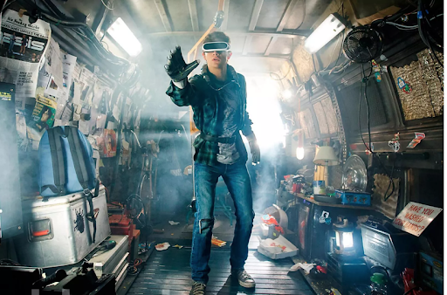
Project 3
insertnames

Slide 2

Problem statement
Using NLP, we created a classification model that can accurately identify social media posts into basketball and baseball interest groups to assist a VR gaming company in:
1
cost savings on their advertising campaign
2
formation of B2B partnerships
Notes:
based on ROC AUC score,
There is a need to identify which subreddit a post comes from, in order to target different customer segments as well selecting appropriate market strategies, for the marketing team of a gaming company, looking into introducing basketball and baseball as sporting games in their latest VR headset offering.
Our chosen model consistently achieved a high score during model evaluation
Naive Bayes

Slide 3
Cleaning
Dropping of duplicate posts (title)
Removing admin posts
Joining of selftexts and title
Notes:
Where data came from?
2 subreddits

Slide 4
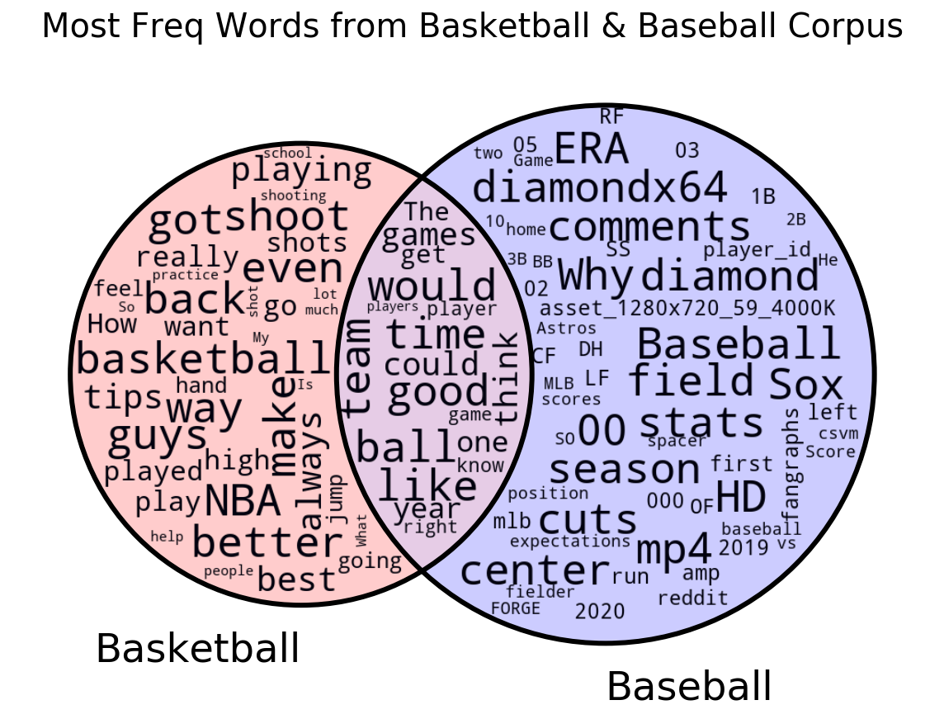

Most Frequent Words from Basketball & Baseball Corpus

Slide 5
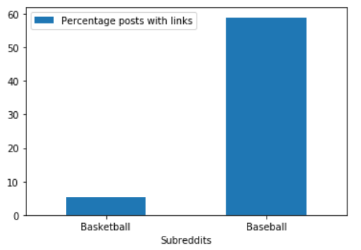
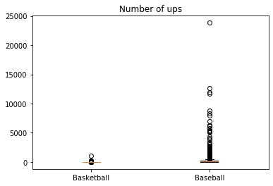
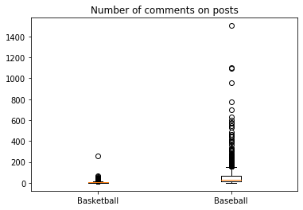
EDA - General observations
Baseball posts are more popular than basketball (1.1m vs 51k members)
Baseball posts contain more links, while basketball posts contain more original texts

Slide 6
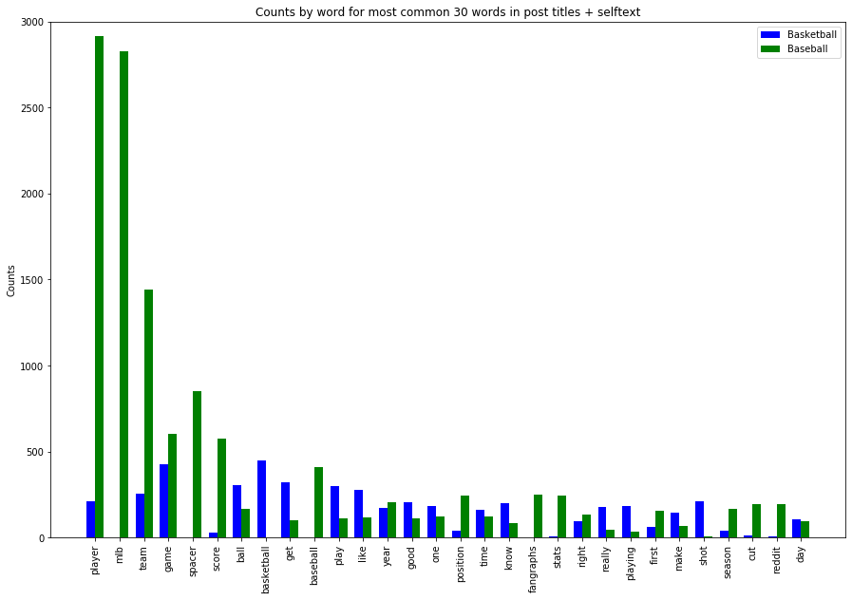
EDA - High word counts
Basketball only | Common words | Baseball only
basketball, playing, shot | game, ball, play, like, year, good, one, time | player, mlb, spacer, baseball, position, fangraphs, stats, season
Notes:
Word frequency orders of magnitude difference -> TFID Vectorizer may work better than CountVectorizer
More than half of top 30 words appear in either basketball or baseball -> Data is easy to work with given distinction between the two

Slide 7
Preprocessing
Converted HTML links to text
Removed non-letters
Converted to lowercase, split into individual words
Removed stop words (included extra words: ‘http’, ‘www’, ‘com’, ‘id’)
Lemmatized words

Slide 8
Modeling
Logistic regression: Classification via a linear equation like algorithm that produces a binary output
Naive Bayes: Classification via a probabilistic classifier like algorithm
XGBoost: Classification via a decision tree like algorithm
Notes:
We can go into many fancy

Slide 9
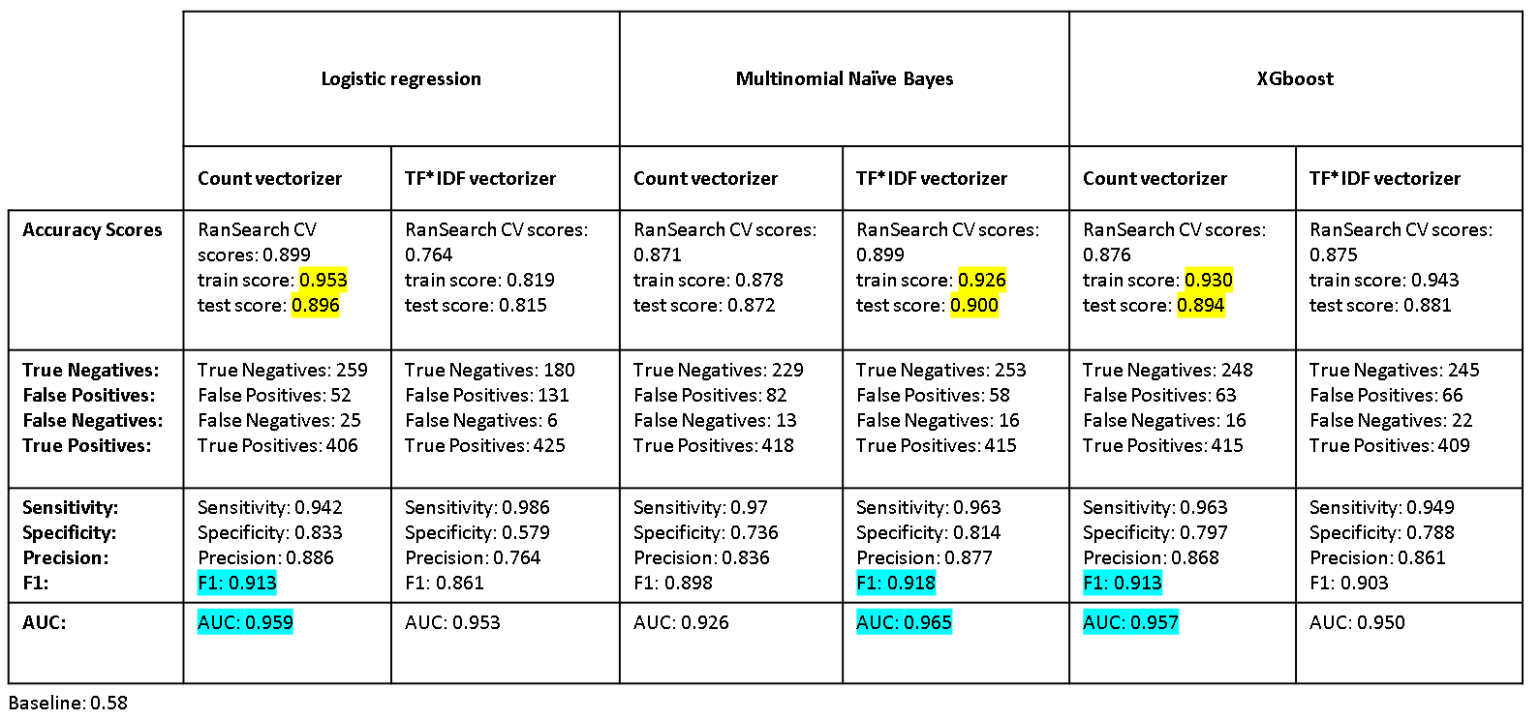
Which model to choose?
Notes:
All beat baseline
Accuracy
F1 and auc is industrial standard
Auc is better because...

Slide 10
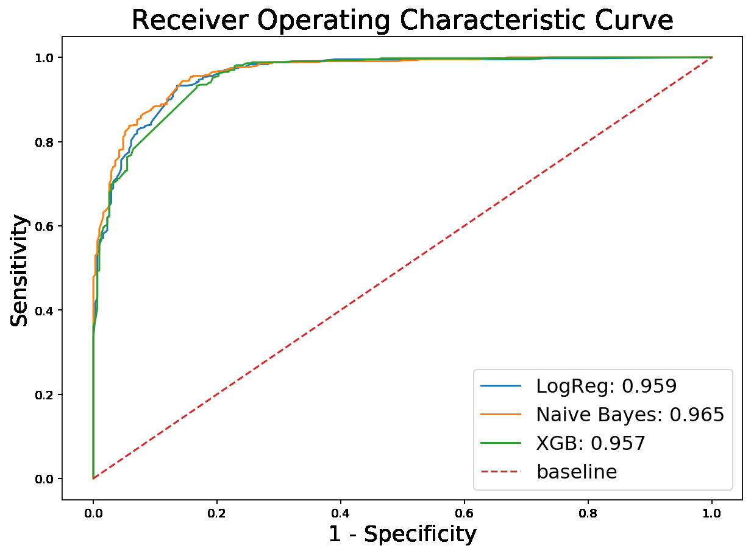
Which model to choose?
Notes:
Why ROC was chosen

Slide 11
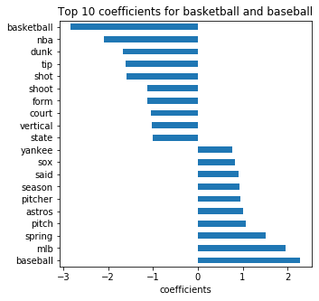
What words were the best discriminators?

Slide 12
Recommendations
Insights
We created an accurate Naive Bayes classifier to identify social media posts into basketball and baseball interest groups.
Basketball posts - techniques in improving the skills as evidenced by popular words such as dunk, shoot & jumpshot.
Baseball posts - baseball teams and games eg fangraphs, 'Mets', 'Astros', 'SOX', 'Red', 'Yankee', 'Angels' etc.
1
2
3
Notes:
Based on our team’s analysis let me share 3 important insights
Our model performed better than a baseline model and had a high ROC-AUC score
We observed that basketball posts tend to be on techniques to improve skills
baseball

Slide 13
Recommendations
Applications
VR content/modules : basketball techniques, baseball teams and players
Partnerships with :
Trainers/coaches for techniques
Sports merchandisers to target baseball team-centered merchandise
Teams to feature player dialogues, snippets, tips and techniques
With our current results, magazines or advertisers may want to better target their audience by producing content well aligned to the interest of the commenters. For example, for basketball commenters maybe more interested in basketball related merchandise (e.g. balls, shoes, coaches, etc.) and information (e.g. techniques), while baseball commenters maybe more interested in baseball games related merchandise (e.g. merchanise of teams) and information (e.g. news on baseball teams and players).
### Recommendations
1) My selected subreddits - 'Basketball' and 'Baseball' were distinctively different so it was not much of a challenge to differentiate them. Most of the vectorizer and models obtained high scores. Perhaps it will be more interesting to explore subreddits like 'nba' and 'basketball' as they may be harder to differentiate, yet there are some subtle differences (suspect 'nba' to be a fan community, while 'basketball' is for basketball enthusiast).
2)
1
2
3

Slide 14
Conclusion
1
Our model predicts very well with text
Our insights provide :
Scope for business opportunities to offer specific products
Targeted cost effective emplacement of advertisements
Future improvements - detect images and videos in posts to further sharpen advertising edge.
2
3

